Slide 1
Probabilistic Programming
Marius Popescu
popescunmarius@gmail.com
2018 - 2019

Slide 2

A More Elaborate “Hello World!”
Your most humble servant and most faithful friend

Slide 3
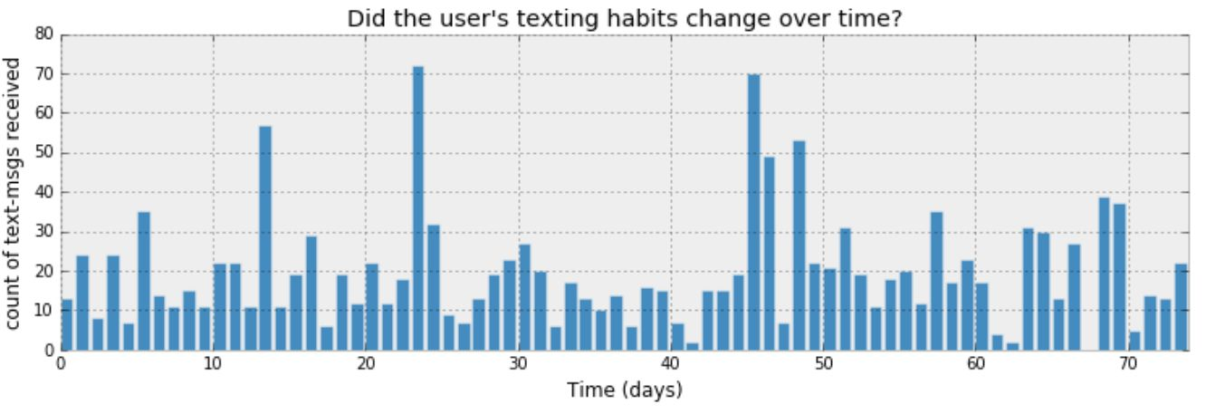
Inferring behaviour from text-message data

Slide 4

How can we start to model this?
Denoting day i's text-message count by $C_{i}$
$C$is a random variable
What can be the distribution of $C$ ?

Slide 5
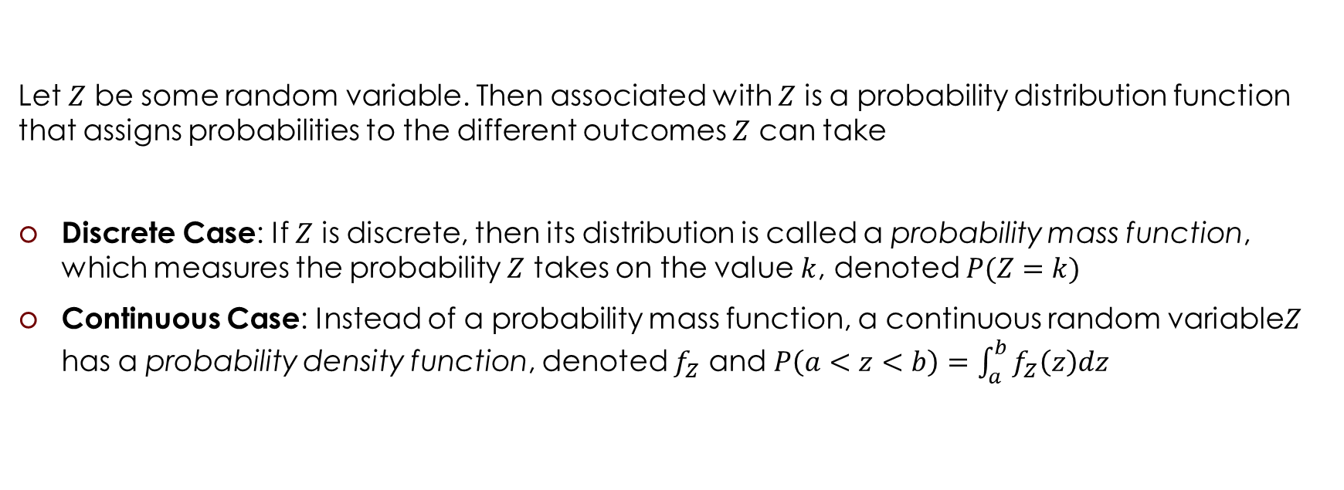
Probability Distributions (Memento)
Let $Z$ be some random variable. Then associated with $Z$ is a probability distribution function that assigns probabilities to the different outcomes $Z$ can take
Discrete Case: If $Z$ is discrete, then its distribution is called a probability mass function, which measures the probability $Z$ takes on the value $k$, denoted $P(Z=k)$
Continuous Case: Instead of a probability mass function, a continuous random variable$Z$ has a probability density function, denoted $f_{Z}$ and $P\left(a<z<b\right)=\int_{a}^{b}{f_{Z}\left(z\right)dz}$

Slide 6
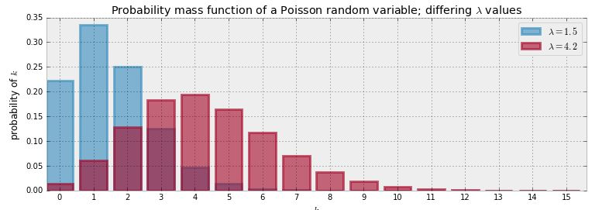

Poisson Distribution (Memento)
$$Z\sim \text{Poi}(λ)$$
$$P\left(Z=k\right)=\frac{λ^{k}e^{−λ}}{k!}, k=0,1,2,…, λ∈ℝ_{>0}$$
$$E\left(Z | λ\right)=\sum_{k=0}^{∞}{kP(Z=k)}= λ$$

Slide 7
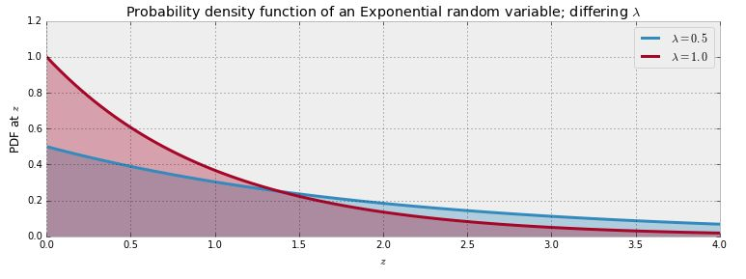

Exponential Distribution (Memento)
$$Z\sim \text{Exp}(λ)$$
$$f_{Z}\left(z | λ\right)=λe^{−λz}, z≥0$$
$$E\left(Z | λ\right)=\int_{−∞}^{∞}{zf_{Z}\left(z | λ\right)dz}=\frac{1}{λ}$$

Slide 8
Modeling

Slide 9

How can we start to model this?
Denoting day i's text-message count by $C_{i}$
$C$is a random variable
What can be the distribution of $C$ ?
A Poisson random variable is a very appropriate model for this type of count data
$$C\sim \text{Poi}(λ)$$

Slide 10
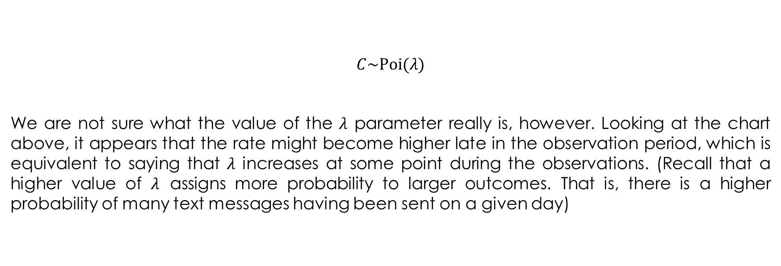
Inferring behaviour from text-message data: prior distributions
$$C\sim \text{Poi}(λ)$$
We are not sure what the value of the $λ$ parameter really is, however. Looking at the chart above, it appears that the rate might become higher late in the observation period, which is equivalent to saying that $λ$ increases at some point during the observations. (Recall that a higher value of $λ$ assigns more probability to larger outcomes. That is, there is a higher probability of many text messages having been sent on a given day)

Slide 11
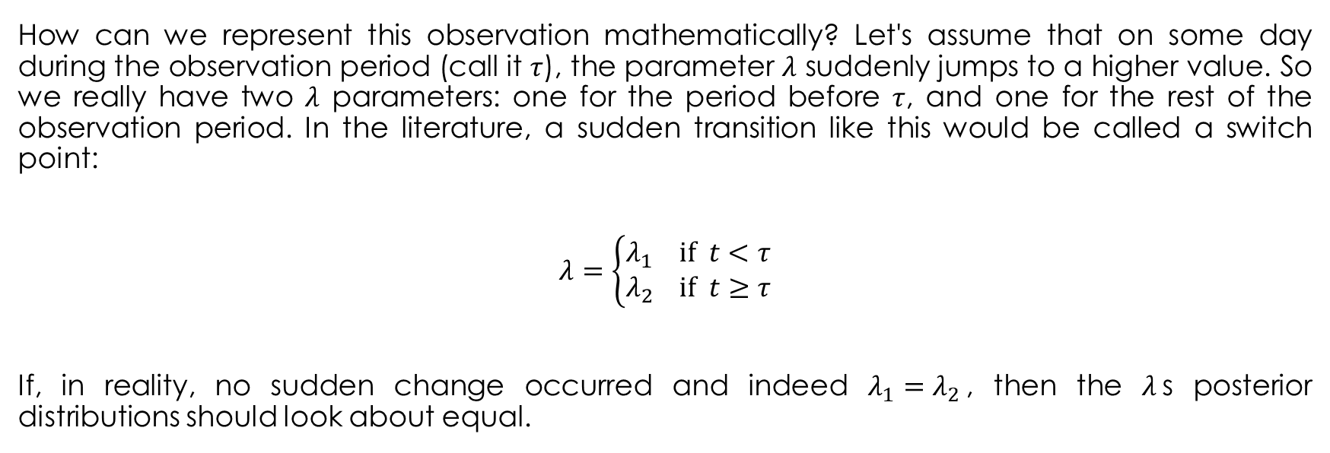
Inferring behaviour from text-message data: prior distributions
How can we represent this observation mathematically? Let's assume that on some day during the observation period (call it $τ$), the parameter $λ$ suddenly jumps to a higher value. So we really have two $λ$ parameters: one for the period before $τ$, and one for the rest of the observation period. In the literature, a sudden transition like this would be called a switch point:
$$λ=\left\{\begin{aligned}λ_{1} \text{if} t<τ \\ λ_{2} \text{if} t≥τ\end{aligned}\right.$$
If, in reality, no sudden change occurred and indeed $λ_{1}=λ_{2}$, then the $λ$s posterior distributions should look about equal.

Slide 12
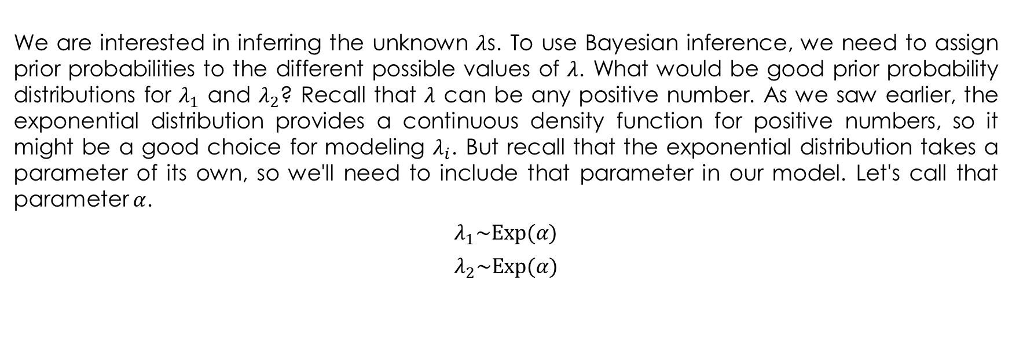
Inferring behaviour from text-message data: prior distributions
We are interested in inferring the unknown $λ$s. To use Bayesian inference, we need to assign prior probabilities to the different possible values of $λ$. What would be good prior probability distributions for $λ_{1}$ and $λ_{2}$? Recall that $λ$ can be any positive number. As we saw earlier, the exponential distribution provides a continuous density function for positive numbers, so it might be a good choice for modeling $λ_{i}$. But recall that the exponential distribution takes a parameter of its own, so we'll need to include that parameter in our model. Let's call that parameter $α$.
$$λ_{1}\sim \text{Exp}(α)$$
$$λ_{2}\sim \text{Exp}(α)$$

Slide 13
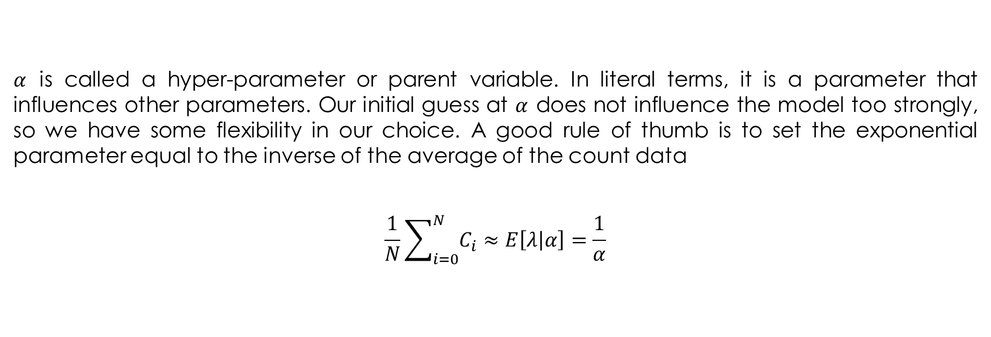
Inferring behaviour from text-message data: prior distributions
$α$ is called a hyper-parameter or parent variable. In literal terms, it is a parameter that influences other parameters. Our initial guess at $α$ does not influence the model too strongly, so we have some flexibility in our choice. A good rule of thumb is to set the exponential parameter equal to the inverse of the average of the count data
$$\frac{1}{N}\sum_{i=0}^{N}{C_{i}}≈E\left[λ | α\right]=\frac{1}{α}$$

Slide 14
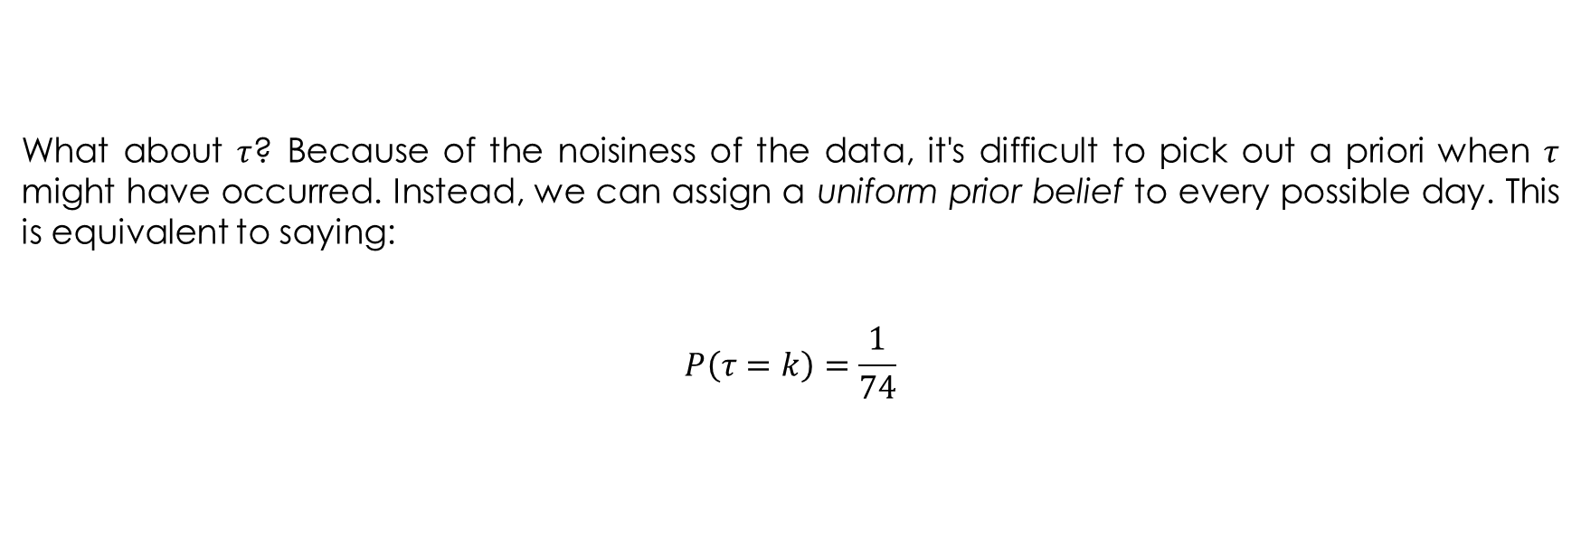
Inferring behaviour from text-message data: prior distributions
What about $τ$? Because of the noisiness of the data, it's difficult to pick out a priori when $τ$ might have occurred. Instead, we can assign a uniform prior belief to every possible day. This is equivalent to saying:
$$P\left(τ=k\right)=\frac{1}{74}$$

Slide 15
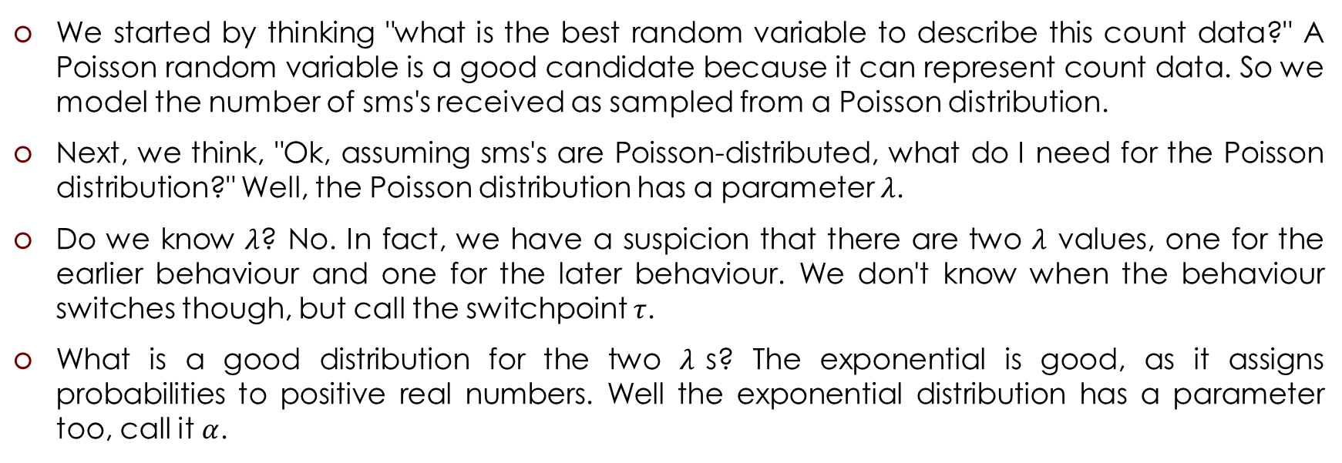
Bayesian modeling is to think about how your data might have been generated
We started by thinking "what is the best random variable to describe this count data?" A Poisson random variable is a good candidate because it can represent count data. So we model the number of sms's received as sampled from a Poisson distribution.
Next, we think, "Ok, assuming sms's are Poisson-distributed, what do I need for the Poisson distribution?" Well, the Poisson distribution has a parameter $λ$.
Do we know $λ$? No. In fact, we have a suspicion that there are two $λ$ values, one for the earlier behaviour and one for the later behaviour. We don't know when the behaviour switches though, but call the switchpoint $τ$.
What is a good distribution for the two $λ$s? The exponential is good, as it assigns probabilities to positive real numbers. Well the exponential distribution has a parameter too, call it $α$.

Slide 16
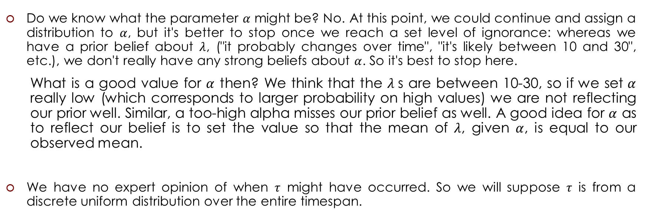
Bayesian modeling is to think about how your data might have been generated
Do we know what the parameter $α$ might be? No. At this point, we could continue and assign a distribution to $α$, but it's better to stop once we reach a set level of ignorance: whereas we have a prior belief about $λ$, ("it probably changes over time", "it's likely between 10 and 30", etc.), we don't really have any strong beliefs about $α$. So it's best to stop here.
What is a good value for $α$ then? We think that the $λ$s are between 10-30, so if we set $α$ really low (which corresponds to larger probability on high values) we are not reflecting our prior well. Similar, a too-high alpha misses our prior belief as well. A good idea for $α$ as to reflect our belief is to set the value so that the mean of $λ$, given $α$, is equal to our observed mean.
We have no expert opinion of when $τ$ might have occurred. So we will suppose $τ$ is from a discrete uniform distribution over the entire timespan.

Slide 17
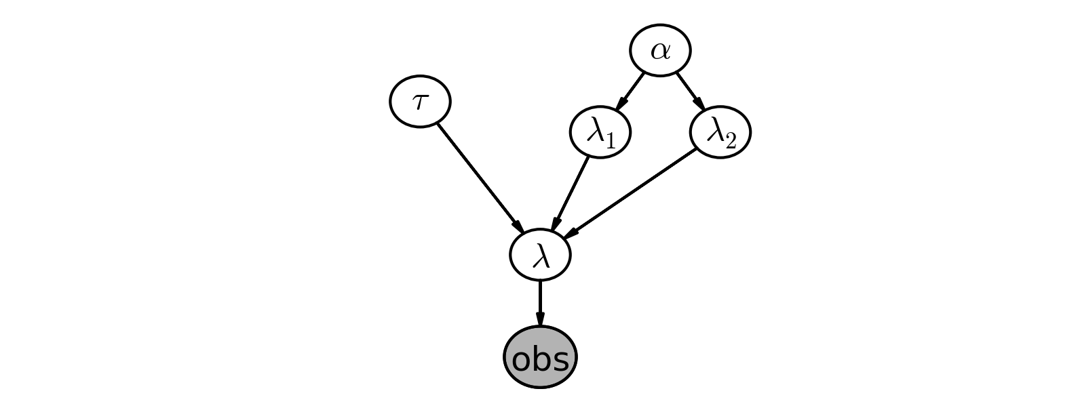
The Model

Slide 18
PyMC Modeling
import numpy as np
import pymc as pm
count_data = np.loadtxt("txtdata.csv")
n_count_data = len(count_data)
alpha = 1.0 / count_data.mean() # Recall count_data is the
# variable that holds our txt counts
lambda_1 = pm.Exponential("lambda_1", alpha)
lambda_2 = pm.Exponential("lambda_2", alpha)
tau = pm.DiscreteUniform("tau", lower=0, upper=n_count_data)

Slide 19
PyMC Modeling
@pm.deterministic
def lambda_(tau=tau, lambda_1=lambda_1, lambda_2=lambda_2):
out = np.zeros(n_count_data)
out[:tau] = lambda_1 # lambda before tau is lambda1
out[tau:] = lambda_2 # lambda after (and including) tau is lambda2
return out

Slide 20
Simulation

Slide 21
PyMC Simulation
n_count_data = 80
alpha = 1.0 / 20.0
observation = pm.Poisson("obs", lambda_, size=80)
model = pm.Model([observation, lambda_1, lambda_2, tau])
mcmc = pm.MCMC(model)
mcmc.sample(40000, 10000, 1)
tau_samples = mcmc.trace('tau')[:]
obs_samples = mcmc.trace('obs')[:]
data = obs_samples[10000][:]
tau = tau_samples[10000]

Slide 22
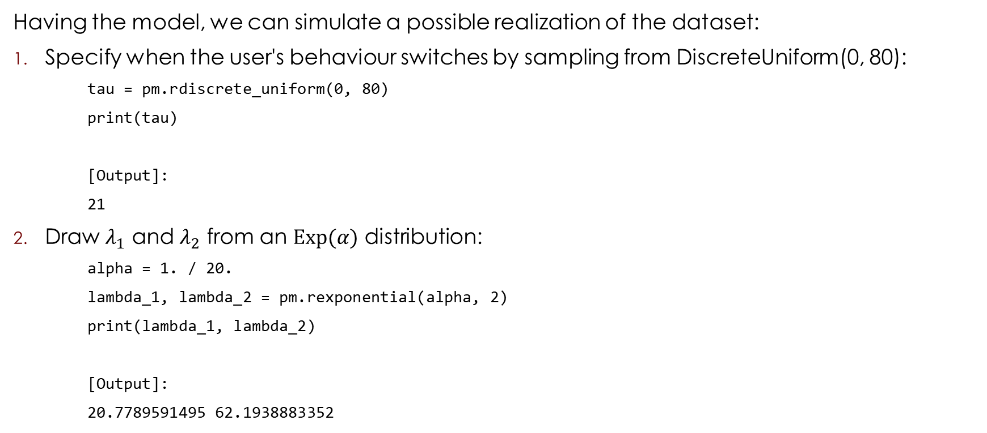
PyMC Simulation
Having the model, we can simulate a possible realization of the dataset:
Specify when the user's behaviour switches by sampling from DiscreteUniform(0, 80):
tau = pm.rdiscrete_uniform(0, 80)
print(tau)
[Output]:
21
Draw $λ_{1}$ and $λ_{2}$ from an $\text{Exp}(α)$ distribution:
alpha = 1. / 20.
lambda_1, lambda_2 = pm.rexponential(alpha, 2)
print(lambda_1, lambda_2)
[Output]:
20.7789591495 62.1938883352

Slide 23
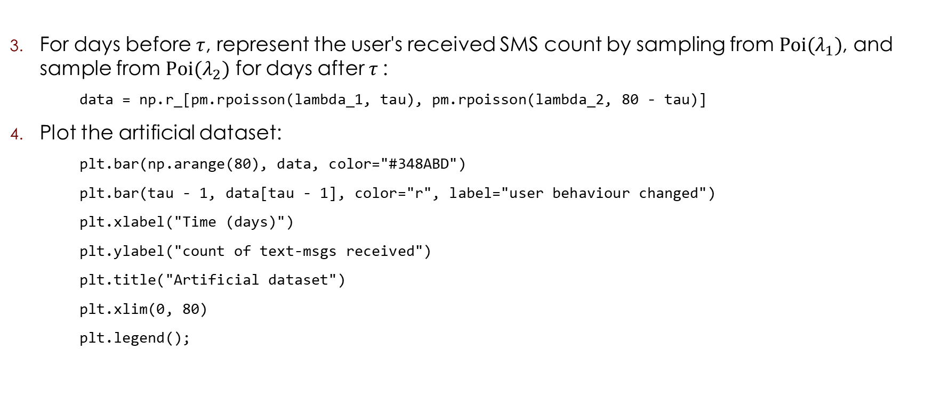
PyMC Simulation
For days before $τ$, represent the user's received SMS count by sampling from $\text{Poi}(λ_{1})$, and sample from $\text{Poi}(λ_{2})$ for days after $τ$:
data = np.r_[pm.rpoisson(lambda_1, tau), pm.rpoisson(lambda_2, 80 - tau)]
Plot the artificial dataset:
plt.bar(np.arange(80), data, color="#348ABD")
plt.bar(tau - 1, data[tau - 1], color="r", label="user behaviour changed")
plt.xlabel("Time (days)")
plt.ylabel("count of text-msgs received")
plt.title("Artificial dataset")
plt.xlim(0, 80)
plt.legend();

Slide 24
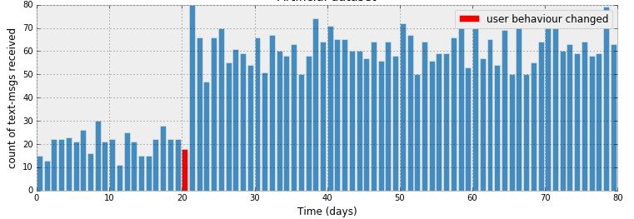
Artificial Dataset

Slide 25
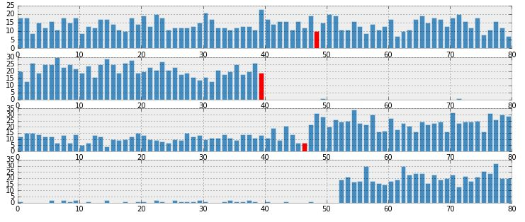
More Examples of Artificial Datasets

Slide 26
Inference

Slide 27
PyMC Inference
observation = pm.Poisson("obs", lambda_, value=count_data, observed=True)
model = pm.Model([observation, lambda_1, lambda_2, tau])
mcmc = pm.MCMC(model)
mcmc.sample(40000, 10000, 1)
lambda_1_samples = mcmc.trace('lambda_1')[:]
lambda_2_samples = mcmc.trace('lambda_2')[:]
tau_samples = mcmc.trace('tau')[:]

Slide 28
Criticism of the Model

Slide 29
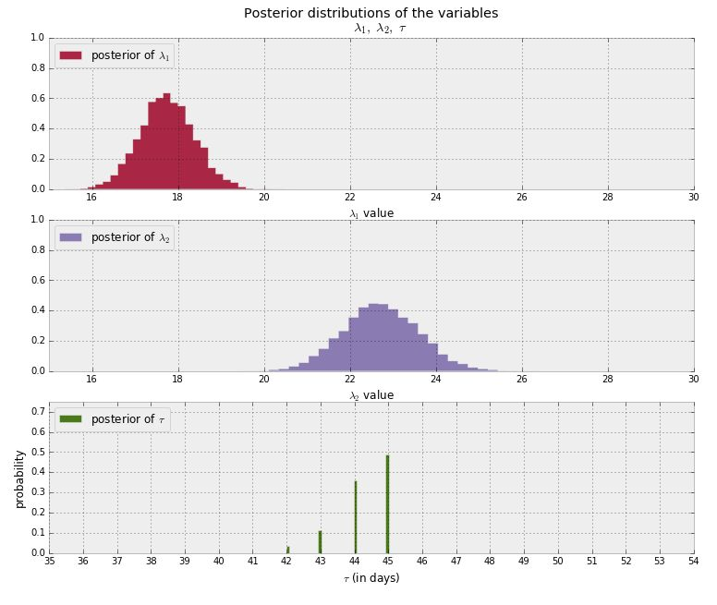
Inferring behaviour from text-message data: posterior distributions

Slide 30
Expected number of texts per day
# tau_samples, lambda_1_samples, lambda_2_samples contain
# N samples from the corresponding posterior distribution
N = tau_samples.shape[0]
expected_texts_per_day = np.zeros(n_count_data)
for day in range(0, n_count_data):
# ix is a bool index of all tau samples corresponding to
# the switchpoint occurring prior to value of 'day'
ix = day < tau_samples
# Each posterior sample corresponds to a value for tau.
# for each day, that value of tau indicates whether we're "before"
# (in the lambda1 "regime") or
# "after" (in the lambda2 "regime") the switchpoint.
# by taking the posterior sample of lambda1/2 accordingly, we can average
# over all samples to get an expected value for lambda on that day.
# As explained, the "message count" random variable is Poisson distributed,
# and therefore lambda (the poisson parameter) is the expected value of
# "message count".
expected_texts_per_day[day] = (lambda_1_samples[ix].sum()
+ lambda_2_samples[~ix].sum()) / N

Slide 31
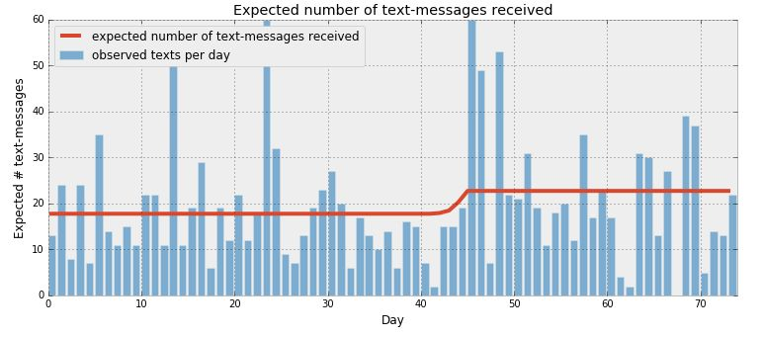
Expected number of texts per day

Slide 32
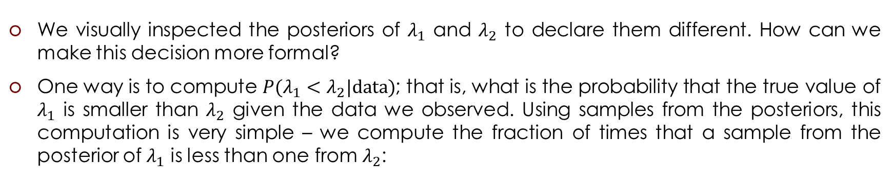
Determining statistically if the two λs are indeed different
We visually inspected the posteriors of $λ_{1}$ and $λ_{2}$ to declare them different. How can we make this decision more formal?
One way is to compute ${P(λ_{1}<λ}_{2}|\text{data})$; that is, what is the probability that the true value of $λ_{1}$ is smaller than $λ_{2}$ given the data we observed. Using samples from the posteriors, this computation is very simple – we compute the fraction of times that a sample from the posterior of $λ_{1}$ is less than one from $λ_{2}$:
print((lambda_1_samples < lambda_2_samples).mean())
[Output]:
0.9998

Slide 33
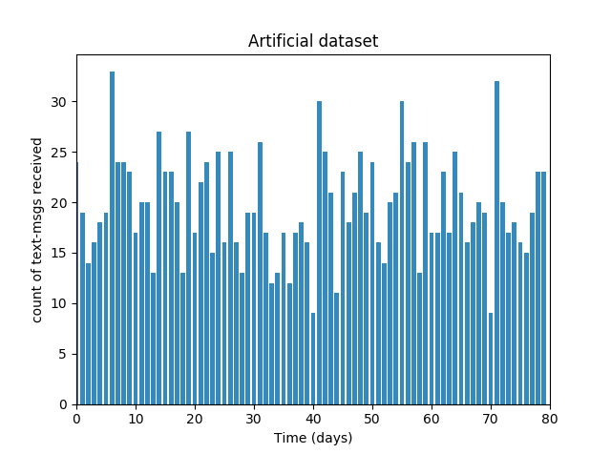

Artificial Dataset
Artificial data set was generated from
a Poisson distribution with $λ=19.255$

Slide 34
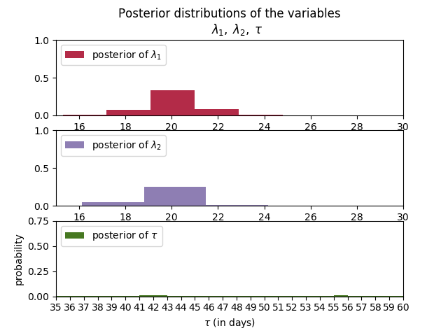
Inferring behaviour from artificial data: posterior distributions

Slide 35
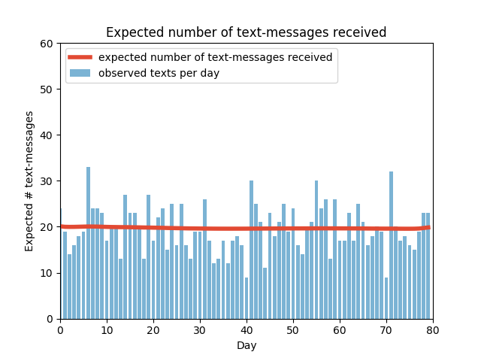
Expected number of texts per day

Slide 36
Determining statistically if the two λs are indeed different
print((lambda_1_samples < lambda_2_samples).mean())
[Output]:
0.3962

Slide 37
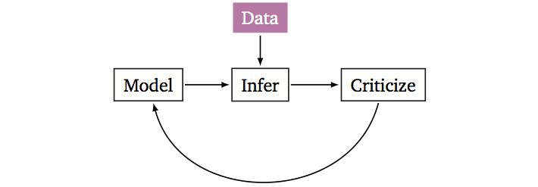
Probabilistic Modeling
Build a probabilistic model of the phenomena.
Reason about the phenomena given model and data.
Criticize the model, revise and repeat.

